Slide 1
Packing the Plane
Matthew Gerstbrein
University of Dayton
November 11, 2017

Slide 2
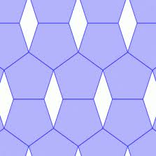
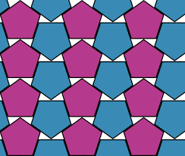
How to pack the plane (with pentagons)
Arbitrary packing:
Optimal packing:

Slide 3
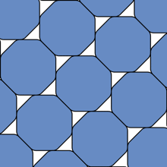

Reinhardt Conjecture
Which convex, centrally symmetric shape has the worst optimal lattice packing?
It can’t be the pentagon both because the pentagon has a packing density which is strictly greater than the circle ((5-sqrt(5))/3 > pi/sqrt(12)), and because it is not centrally symmetric.
The Reinhardt Conjecture hypothesizes the answer is the smoothed octagon, where the corners of the octagon have been replaced with hyperbolic arcs of maximal curvature.
It has been proven that the shape exists, has no corners, and is subject to a hexagonal symmetry constraint.

Slide 4
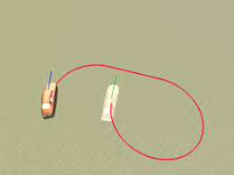
Dubins car problem
As stated by Hales in his ‘Bad Packings’ presentation:
“The Dubins problem is to take a car that is at a certain
position and direction in the plane and navigate it to an ending
position and direction in such a way that the absolute value of
the curvature of the path is at most 1, and to find the shortest
such path.”
This seemingly unrelated problem allows the Reinhardt conjecture to be re-contextualized as an optimal control problem.

Slide 5
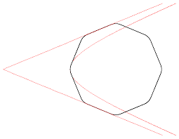
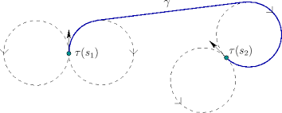
Re-interpret Reinhardt
Smoothed octagon
Optimal control (Dubins) problem
Straight line segments and segments
of maximal curvature in both situations

Slide 6



An optimal control problem
Control simplex:
Differential equations:
Cost:
*a, b, and c are functions of u = (u0, u1, u2)
Because the Reinhardt conjecture can be re-contextualized as a problem in optimal control theory, it must possess the same properties as an optimal control problem.
According to Wikipedia:
“Optimal control deals with the problem of finding a control law for a given system such that a certain optimality criterion is achieved. A control problem includes a cost functional that is a function of state and control variables. An optimal control is a set of differential equations describing the paths of the control variables that minimize the cost function.”
Furthermore, the Reinhardt problem inherits another property of the Dubins car problem: it has a bang-bang solution.

Slide 7
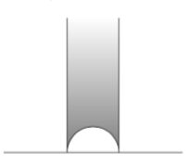
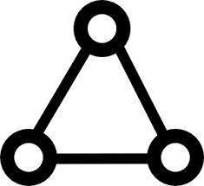

Simplifying
The solution is bang-bang; in other words, the control state can only be at one of three extremal points of U, which are the vertices of the triangle:
e1 = (1, 0, 0)
e2 = (0, 1, 0)
e3 = (0, 0, 1)
This drastically simplifies the differential equations, especially in the cases of e2 and e3. For e2 and e3, the solutions to these equations are lines. The solution for e1 control is more complicated, but turns out to be circular arcs. The precise equations are dependent on the initial conditions.
All trajectories take place in the upper half-plane of the complex plane; specifically, on a constrained region.
A picture of the star region.
The complete trajectory must
lie in the interior of this region.

Slide 8
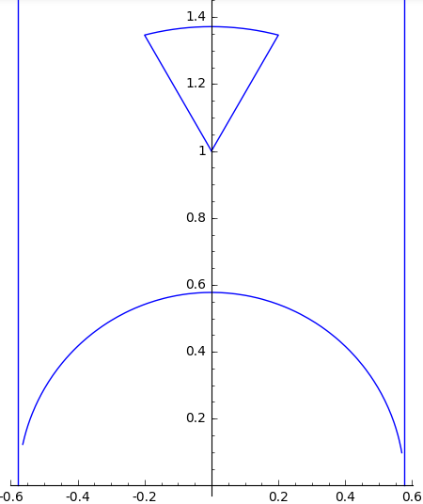
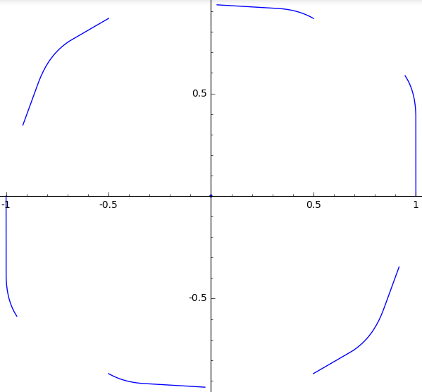
Correspondence with shape
Given a trajectory that is traced out in the star region given a particular set of controls, we can construct a shape in the traditional 2-d plane . The equation is complicated, so it is sufficient to recognize the existence of a correspondence, without explicitly detailing the correspondence. For completion’s sake, the relationship is:
where
The result is a matrix in SL2(R).
This matrix acts on the sixth roots of unity (n-th roots of unity for n=6), generating a hexagonally symmetric shape. Note that the shape is not necessarily closed.

Slide 9

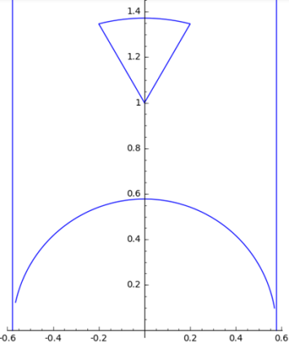

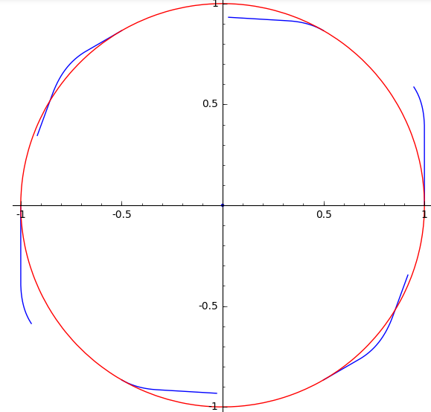
To summarize
Given Reinhardt problem’s corresponding differential equations for the optimal control, we can solve the differential equations assuming bang-bang control. These paths in the star region of the upper half-plane, when pieced together, correspond to a shape in the traditional 2-d plane. It is this shape that we are packing optimally in the plane, and the optimal packing density is the cost.

Slide 10
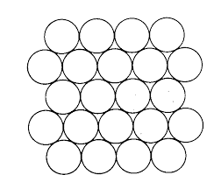
My research
Given the properties of the optimal control problem as outlined by Hales, can we explicitly construct a closed shape whose cost is strictly less than that of the circle?

Slide 11
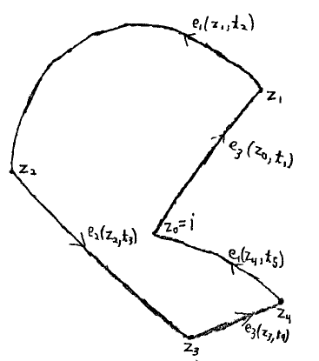
How to go about this
Via the process previously described, we can construct a circle with constant control u = (1/3, 1/3, 1/3), where the solution is x + iy = 0+ i*1 = i. Thus to construct a shape with strictly worse packing density, we would like to deform the circle in some hexagonally symmetric way.
We do this by setting our initial conditions in the star region at z = i, then taking bang-bang control in some manner such that we return to z = i in finite time.
A desirable method of construction should:
be (reasonably) easy to compute
use bang-bang control

Slide 12

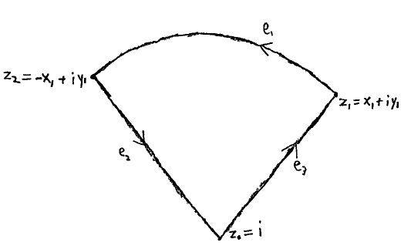
Minimize computation
Arbitrary control trajectory:
‘Triangle’ control trajectory:

Slide 13
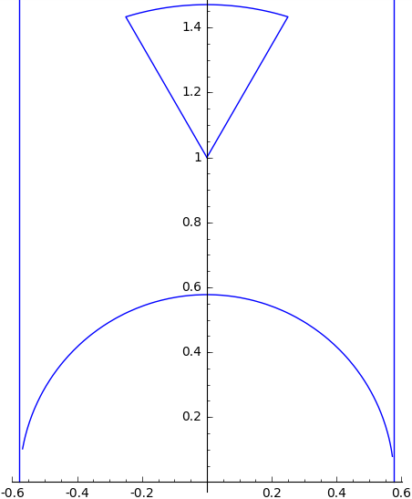
Benefit of triangular control trajectory
It depends on only one parameter: x1
minimizes computation

Slide 14
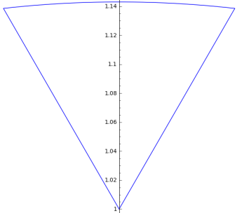
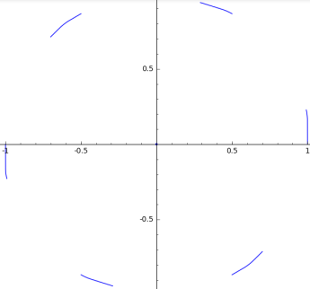
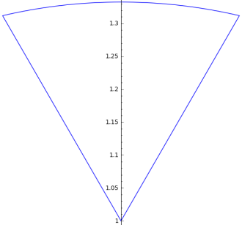
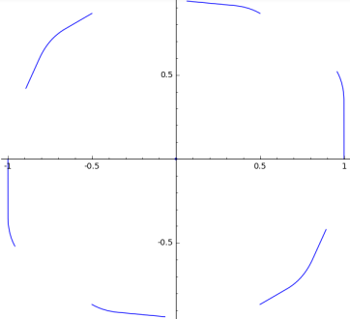
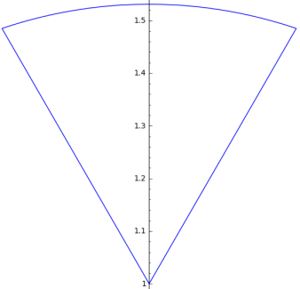
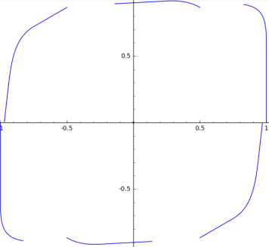
Does it work?
Examples of triangular control trajectories:
Corresponding shapes:

Slide 15
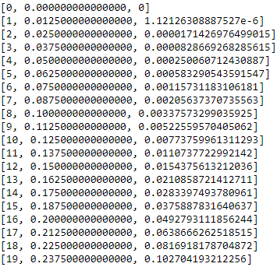
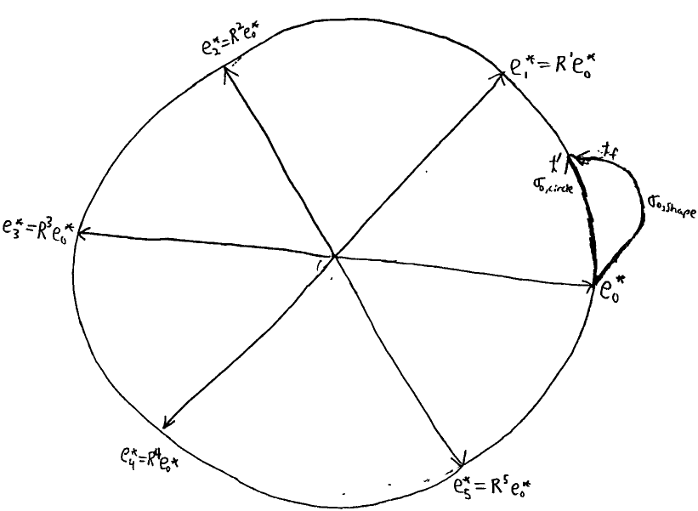
It’s hard to tell
By visual inspection, it is not particularly obvious whether a given trajectory is going to form a shape that is a continuously differentiable deformation of the circle.
We developed a more systematic method to quantify whether a shape had the potential to be a smooth deformation.
Parameter
Error
As the parameter is increased,
the error grows larger.

Slide 16
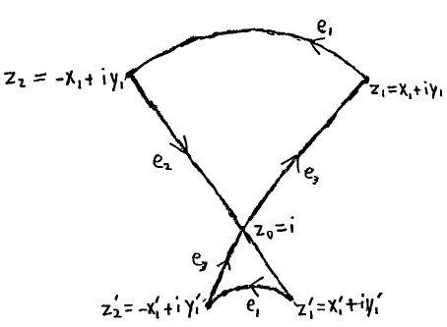
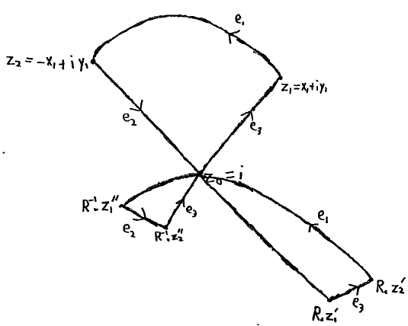
Other ideas?
We needn’t restrict ourselves to this ‘triangle’ trajectory. Rather, we can develop new trajectories. The game becomes how to piece together solutions of the differential control equations, that is, lines and circular arcs, such that we start and end at
z = i.
In principle, the way we go about this task is arbitrary without any fundamental insight; however, we would still like to minimize computation to the extent that we can.
Thus, we developed these trajectories, perhaps considered to resemble an hourglass and a cloverleaf.
These have 2 and 3 parameters, respectively. More parameters yields more control.

Slide 17
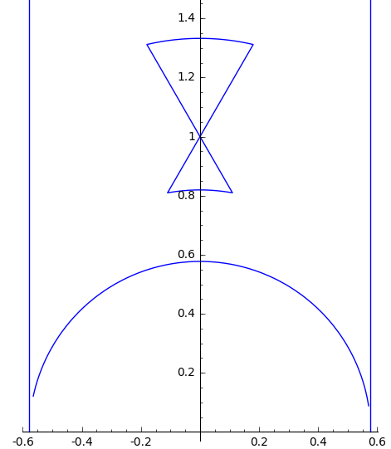
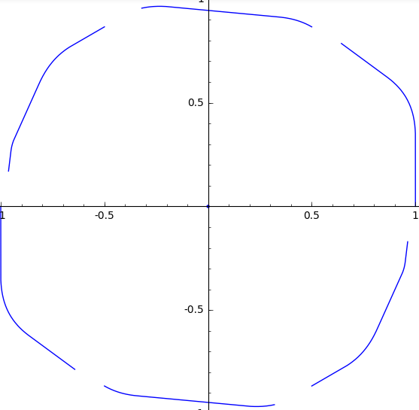
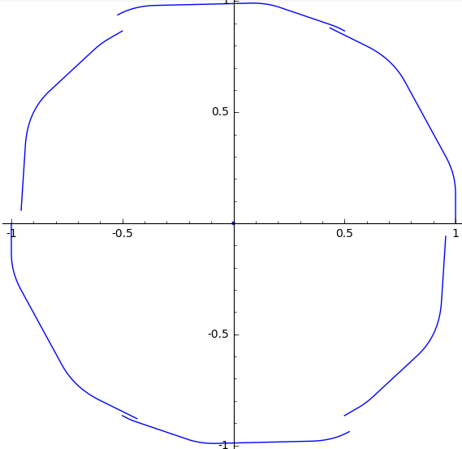
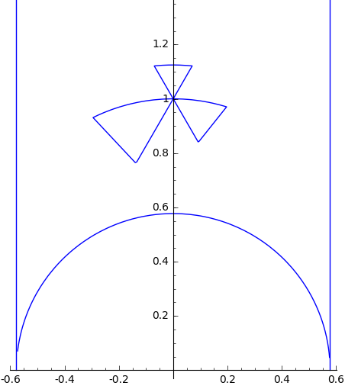
Any luck?
Two, three parameter control trajectories
Corresponding shapes

Slide 18
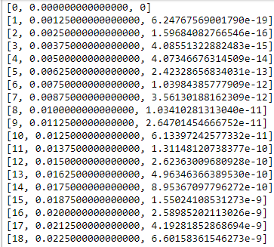
What do the computations say?
While the shapes are nearly closed, we also require them to be smooth deformations of the unit circle, meaning that they are continuously differentiable. The prior examples are not. But could there be others.
This list of ‘errors’ through three-parameter trajectories of equal inputs illustrates how close we can come an error of 0.

Slide 19
Unexpected outcome
‘Clover leaf’ captures three-piece hyperbolic symmetry of star region
yet we still find no solution
What arrangement of controls will yield our desired outcome?

Slide 20
Further information
reinhardt-control-trajectory
GitHub, matthew-gerstbrein
code and project synopsis
“The Reinhardt Conjecture as an Optimal Control Problem”, Thomas Hales
on arXiv

Slide 21
Thanks for your time!

